Slide 1
Tangent and normal
(in polar coordinates)

Slide 2
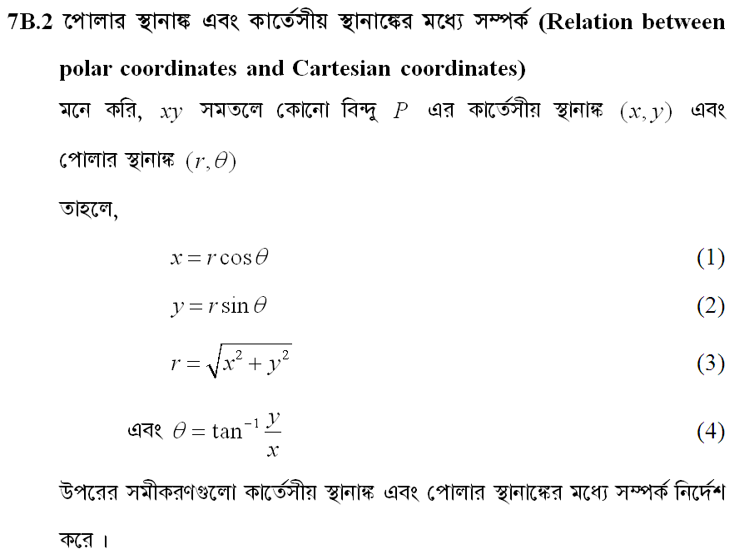

Slide 3
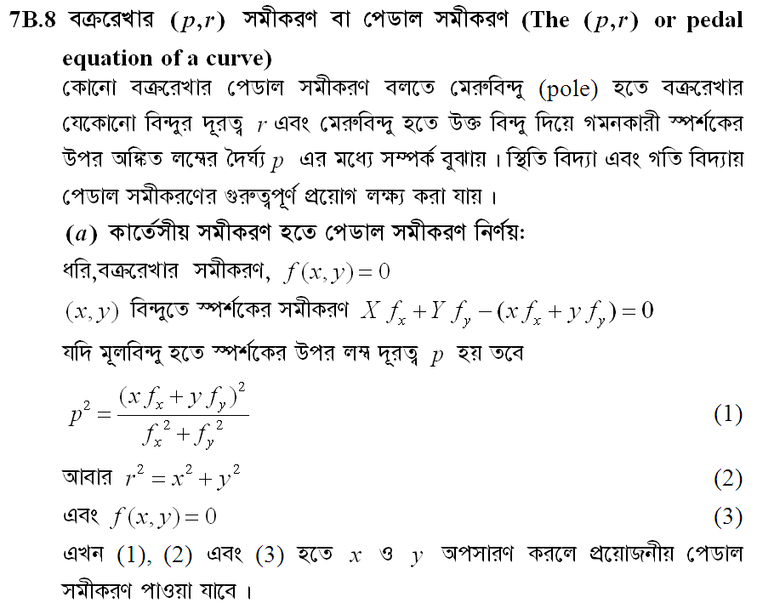

Slide 4
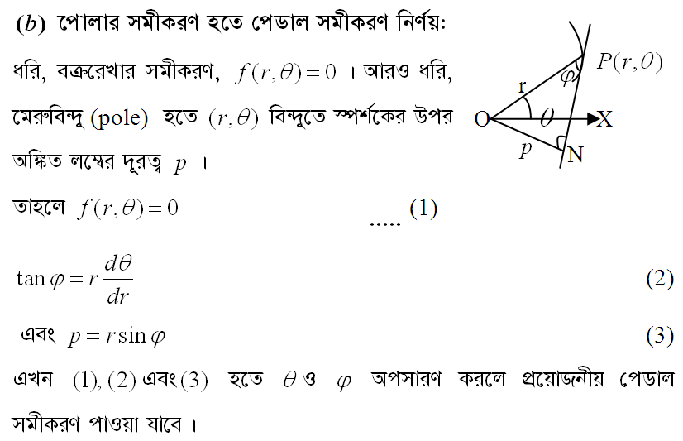

Slide 5
