Slide 1
Discrete Mathematics
Science View Publications

Slide 2
Definitions

Slide 3
Definitions

Slide 4
Definitions

Slide 5
Definitions

Slide 6
Definitions

Slide 7
Definitions

Slide 8
Definitions

Slide 9
Definitions

Slide 10
Truth Tables

Slide 11
Truth Tables

Slide 12
Truth Tables

Slide 13
Truth Tables

Slide 14
Truth Tables

Slide 15
Truth Tables

Slide 16
Truth Tables

Slide 19
Definitions

Slide 20
Definitions

Slide 21
Definitions

Slide 22
Algebra of Propositions

Slide 23
Algebra of Propositions

Slide 24
Definitions

Slide 25
Definitions

Slide 26
Definitions

Slide 27
Definitions

Slide 28
Definitions

Slide 29
Definitions

Slide 30
Definitions

Slide 31
Definitions

Slide 32
Definitions

Slide 33
Definitions

Slide 34
Rules of Inferences

Slide 35
Definitions

Slide 36
Definitions

Slide 37
Definitions

Slide 38
Definitions

Slide 39
Solved Problems

Slide 40
Solved Problems

Slide 41
Solved Problems

Slide 42
Solved Problems

Slide 43
Solved Problems

Slide 44
Solved Problems

Slide 45
Solved Problems

Slide 46
Solved Problems

Slide 47
Solved Problems

Slide 48
Solved Problems

Slide 49
Solved Problems

Slide 50
Solved Problems

Slide 51
Solved Problems

Slide 52
For practice

Slide 53
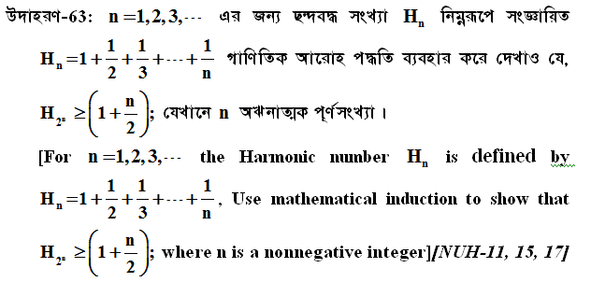
For Practice

Slide 54
Thank You

